Slide 1
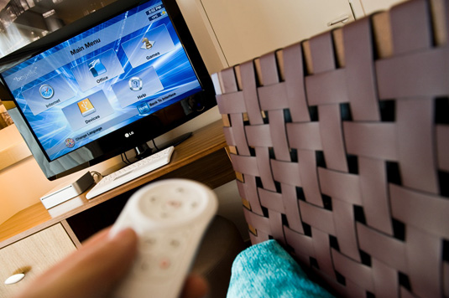
IPTV Technology

Slide 2
Outline
What is IPTV
IPTV Services
IPTV Requirements
Network Architecture
IPTV Components
Key IPTV Technologies
IPTV Security
Future of IPTV

Slide 3
What is IPTV?
“IPTV is defined as multimedia services such as television/video/audio/text/graphics/data delivered over IP based networks managed to provide the required level of quality of service and experience, security, interactivity and reliability.”
ITU focus group on IPTV
Use Access Networks to reach clients, not general internet links
IPTV is not audio/video through the internet

Slide 4
Internet TV & IPTV
 | Internet TV | IPTV
Transport | Use general internet | Use dedicated, private network
Geographical Reach | Can be access from anywhere in the globe | Limited by service provider
Service quality | Not guaranteed | Guarantees high quality audio and video
Access Mechanism | A PC with media player | Set-Top-Box most of the time
Content Generation | Use own content | Provided by existing TV broadcasters

Slide 5
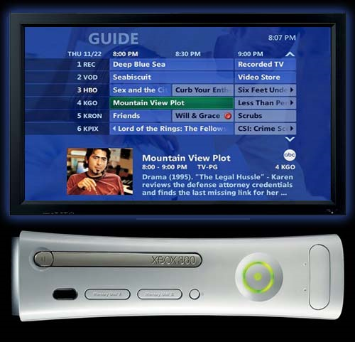
IPTV Services
Basic and Premium Television
Interactive TV / Two way communication
HDTV
Video on Demand
Time shifted TV
Instant Messaging
TV Telephony
Gaming and Betting on Demand
Web and e-mail

Slide 6
Why IPTV?
More control over service for user
What to watch and when to watch
More interactive
Better Quality
DVD quality video, CD quality music
Personalization
Convergence – Single device to watch TV, surf web and video calling
PC is not attractive due to lower picture quality, cost and boot time
Notes:
What makes the customers move from traditional TV to IPTV

Slide 7
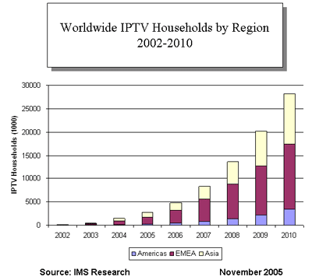
Growth of IPTV
Factors helped the growth
Digitization of content
Development of compression techniques
Growth in Broadband use
Sri Lankan situation
IPTV available for ADSL users

Slide 8
IPTV Process
Content Production
Content Aggregation
Content Delivery
Content Reproduction
End User
Program Production
TV Stations
IPTV Service Providers
TV Sets
IPTV Content Delivery:
TV Head End
IPTV Middleware
VOD Systems
Media Content Protection Systems (DRM)
IP STB

Slide 9
IPTV Requirements
Bandwidth for access link
4 Mbps per channel for SDTV
HDTV: 20 Mbps per channel
VoD:
Quality of Experience (QoE) – Step beyond QoS
QoE
QoS
Low delay, jitter and packet loss
Low downtime, maintenance intervals and channel change time

Slide 10
IPTV Technical challenges
Bandwidth requirements for streaming
High bandwidth continuously
Last mile is the problem
DSL originally employed for burst (web) traffic, Not support MPEG-2
Need to compress the video streams
Reducing channel change time
Due to multicasting it takes time
Providing VoD
Need to unicast messages

Slide 11
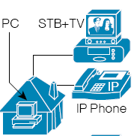
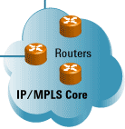
IPTV Network
Regional Head End
Home Network
Access Network
National Head End
IP Core Network

Slide 12
IPTV Protocols
MPEG-4 / H.264
RTSP
RTP
UDP
TCP
IP
IGMP
XDSL, Metro Ethernet, ATM

Slide 13
IPTV Head End
Acquiring video from different sources
Video Encoding
VoD delivering
Content security
Conditional Access System (CAS)
Digital Rights Management (DRM)
EPG Server
OBSS – Subscriber management system
MPEG Encoder
MPEG Encoder
Media Streamer
IPTV Delivery Network
CAS
DRM
Live TV
OBSS
VoD Server
Notes:
CAS/DRM – Combination of Scrambling and Encryption

Slide 14
Core Network
High speed data network
Technologies used:
ATM and SONET/SDH
IP and MPLS
Metro Ethernet

Slide 15
IPTV Last Mile (Access Network)
From IPTV Data Center to the subscriber
Fiber
DSL
Cable TV
Satellite
Wireless Broadband
Internet

Slide 16
IPTV Over ADSL

Slide 17
IPTV Middleware
Middleware – A distributed operating system to connect IPTV components
Runs on IPTV servers and IP-STBs
Integrates with VOD system, Headend, CA/DRM, STB and the network
End-to-end configuration
User management
Interactive services
Provides channel/package and program together with pay TV solutions
Links the electronic program guide (EPG) with the content
Acts as a boot server for the STB and ensures that all STBs run compatible software

Slide 18
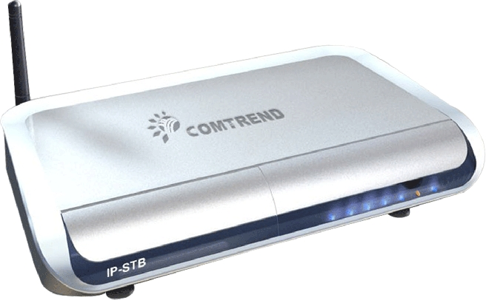
IP STB
IPTV hardware and software infra-structure at customer premises
Runs the IPTV middleware at client side
Decrypt the scrambled video stream
Video decoding
Produce composite (analog) video output
Program navigation with EPG
PVR

Slide 19
IP STB - Operation
User wants to watch TV channel
User watches TV channel
IP-STB connects to appropriate multicast group
IP-STB recieves packets and encodes it
IP-STB recieves packets, encodes it and sends to output device

Slide 20
IP STB - Hardware

Slide 21
IP STB - Software
Hardware drivers and media codec
Operating system and network stack
IPTV Client
TCP/IP Stack
TV browser
Various plug-ins

Slide 22
IPTV Content Security
CAS – protect the content from illegal use
Smart card based CA system
TV Signal
CAS
ECM generator
Multiplexer
TV distribution network
Set-Top Box
(decryption)
OBSS
EMM generator
Call collector
Transaction data

Slide 23
IPTV Content Security
Digital water marks
REL Application
Key generation
Encryption
DRM Client module
DRM – Protection against theft and piracy of digital media content

Slide 24
Key IPTV Technologies
Channel change on IGMP
IGMP LEAVE ‘Green’
TV Content
User
Node A
Node B
IGMP JOIN ‘Red’
TV Content
User
Node A
Node B
TV Content
User
Node A
Node B

Slide 25
Key IPTV Technologies
Video Encoding
Improvement in compression to reduce BW requirement

Slide 26
Future of IPTV
TV set become a all in one box
Replace the PC for entertainment (Limit it for programming, documenting)
Everything (e-mail reading, FB, answering calls) from TV remote controller

Slide 27
Q & A

